Slide 1
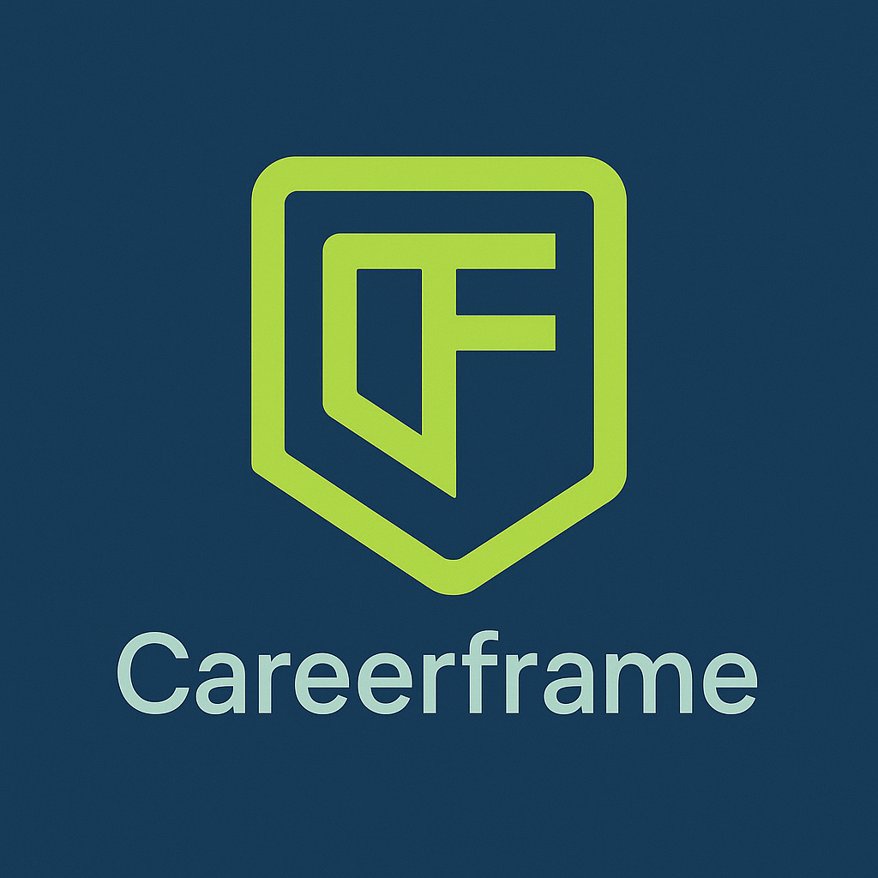



Products
Pricing
Sign in
Join For FREE
Imagine Waking Up Excited for a Career That Truly Fulfils You — We’ll Help You Get There
With CareerFrame’s personalized coaching, powerful insights, and a clear roadmap, we’ll help you unlock your true potential, bridge skill gaps, and step into a career that inspires and drives you every day
Join The Team

Slide 2
Feeling stuck in a job that doesn’t excite you? Every day feels like you’re not reaching your full potential, just going through the motions without fulfilment.
The longer you stay in that job, the more you miss out on the opportunities that could change your life. The routine becomes draining, and the fear of stepping into something new only holds you back from the career you deserve.
CareerFrame is here to help you break free. With personalized coaching, skill gap analysis, and tailored career paths, we’ll guide you to a job that excites and motivates you every day. Whether you want to advance, switch careers, or upskill, your future starts now.
Video

Slide 3
💼Personalized Career Coaching
Get expert guidance every step of the way. Our AI-powered coach builds a relationship with you, offering tailored advice and strategies that align with your unique strengths and career goals.
🔍 Skill Gap Analysis & Growth
Discover exactly where you stand. CareerFrame identifies the gaps between your current skills and the ones required for your dream role, giving you a clear path to grow and advance in your career.
🛤️ Tailored Career Pathways
No one-size-fits-all approach. CareerFrame creates a bespoke roadmap for your career, matching you with the right opportunities and learning resources to help you unlock your true potential and land the role you deserve.

Slide 4
Testimonials

Slide 5
Features
1. 💼 Personalized Career Coaching
Tailored AI-powered coaching offering personalized advice and action plans to guide your career journey.
2. 🔍 Skill Gap Analysis
Assess your current skills, identify gaps, and receive recommendations to elevate your qualifications.
3. 🛤️ Tailored Career Pathways
Receive a bespoke roadmap with clear milestones and tailored career opportunities based on your goals.
4. 📝 AI-Powered Resume Builder
Generate a professional, optimized resume tailored to the job you're aiming for with AI-driven insights.
5. ✍️ AI-Generated Cover Letter
Automatically generate a personalized cover letter that fits the specific role you’re applying for.
6. 📊 Milestone Tracker
Track and celebrate career progress with personalized goals and visible milestones (Premium: Full visibility).
7. 🧭 Explore Roles Access
Get limited (Freemium) or unlimited (Premium) access to in-depth role insights, including job fit, salaries, and perks.
8. 📈 Deep Skill Gap Analysis (Premium)
Receive a detailed skill gap report to understand areas needing improvement for career advancement.
9. 🎮 XP Points & Rewards (2 x XP Premium)
Earn XP points for completing milestones and unlock rewards to accelerate your career progress.
10. 🤝 Team Networking (Freemium & Premium)
Connect with other professionals through team networking groups (Premium: Industry-specific communities).
11. 🔑 Career Alignment & Role Insights (Freemium & Premium)
Get in-depth role overviews and personalized recommendations based on your skills, experience, and career aspirations.

Slide 6
Process Section
Step 1🚀
Sign up and complete your profile. Tell us about your skills, goals, and aspirations so we can create a personalized career plan just for you.
You’ll start your customized career journey with AI-powered career coaching and personalized insights that will shape your path to success.
Step 2🧭
We analyse your profile, identify skill gaps, and provide you with a tailored career roadmap. You’ll receive actionable steps, milestone tracking, and a skill Gap Analysis this aligned with your goals. Your AI career coach will guide you at every step, adapting to your progress and offering the support you need.
Step 3🎯
With CareerFrame, you’ll gain the confidence, skills, and opportunities to step into the career you’ve always wanted. Whether it’s advancing in your current field, switching to a new role, or unlocking higher-paying opportunities, you’ll have the tools, insights, and support to make your dream career a reality.

Slide 7
FAQs https://youtu.be/trfDoGoXNsE?si=tuiRsI3GMOAyux2d https://youtu.be/WgXU7XAZYmQ?si=cffhYgjeogzWe1bQ
Your Future Starts Now — Take the First Step Toward a Career You Love
Join For FREE

